Slide 1

DW2009
Functional ingredient
for cognition improvement

Slide 2
Contents
Ⅰ
Introduction of DongWha
Ⅱ
DW2009
Cognitive function
Ⅲ
Summary
Ⅳ
Contact

Slide 3

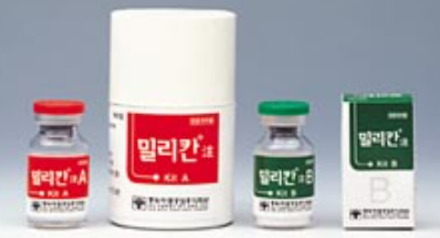
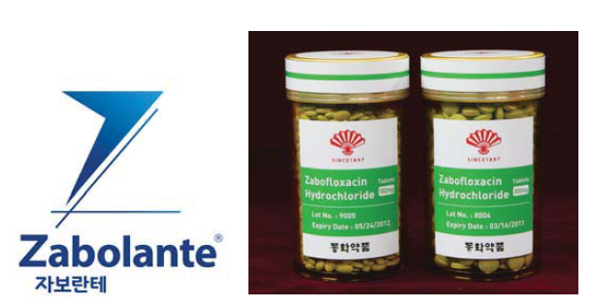

Ⅰ
Introduction of DongWha
Overview
New drugs
Company
Dong Wha PHARM.
2001
Milican Inj.
2015
Zabolante
Foundation
1897: Korea’s first and oldest
pharmaceutical company
Seoul, Korea (Head-quarter)
Yongin-si, Korea (Research Institute)
Chungju, Korea
(Plant, cGMP manufacturing facility)
Location
Staff
801 employees (2023.08)
New drug, generic, OTC,
functional ingredients, etc.
The first radiopharmaceuticals
for the liver cancer in the world.
A new synthetic quinolone
antibacterial compound.
Area of interest
History
The Central Research Center
was established
A new synthetic quinolone
antibacterial compound “Zabolante”
1973
2015
2001
2022
The world’s first radiopharmaceutical
for liver cancer “Milican Injection”
First functional probiotics for
cognitive function improvement “DW2009”

Slide 4










Ⅰ
Introduction of DongWha
Global DongWha
Ireland
Denmark
Mongolia
Switzerland
Germany
Portugal
Japan
USA
Spain
Italy
Mexico
Vietnam
Philippine
Indonesia
License Out
Australia
License In
Export Status
We have been making a consistent effort to build
a successful innovation with external partners.

Slide 5
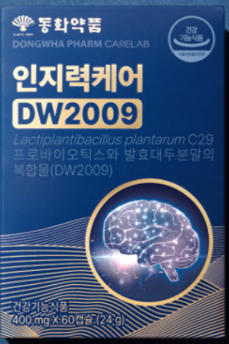
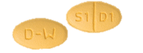

Ⅰ
Company overview
R&D pipelines
Category
Project
Indication
Hit
Lead
Candidate
Preclinical
Clinical
Approval
DW1023
Solid tumors
IND profiling, submission in 2024
DW1024
Immunology
New drug
DW1030
Sarcopenia
DW1031
Fibrosis
Category
Project
Indication
Discovery
Preclinical
Clinical
Approval
DW2009
Cognitive function
Functional
food
24/07
Product
launched
DW2012
Muscle strength
24/12~ Clinical study starts
DW2013
Women’s health
DW6012
Launched
IMD
DW6013
Diabetes
DW6014

Slide 6
Ⅱ
DW2009
Pipeline overview
Product
Complex of Lactiplantibacillus plantarum C29 probiotics and fermented soybean powder
(DW2009)
MoA
Cognitive improvement by up-regulation of BDNF and down-regulation of neuroinflammation
Function
Improvement of cognitive function decreased by aging
Modality
Functional ingredient
Regimen
800 mg, once a daily
Stage
Functional ingredient certified by KFDA (2022.12)
Product launched on July 29, 2024
* BDNF: Brain-derived neurotrophic factor

Slide 7
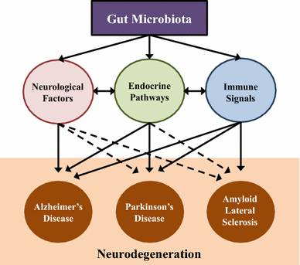
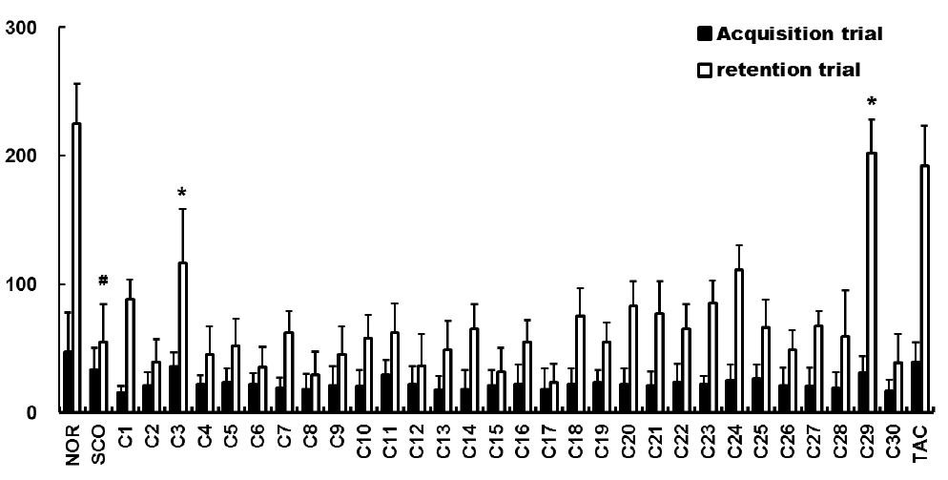
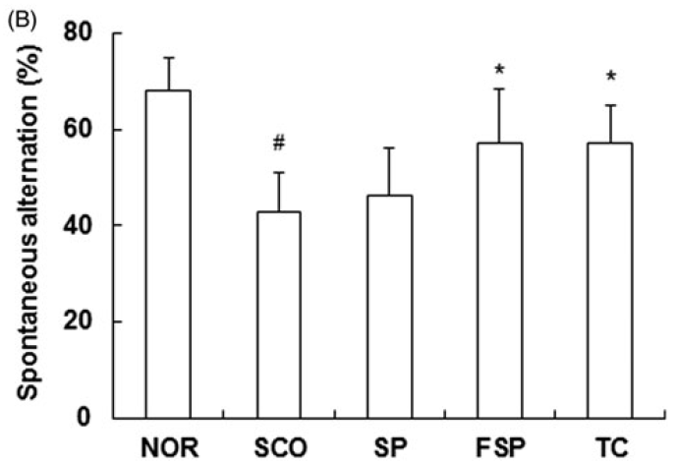
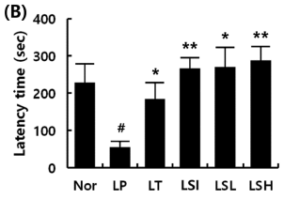
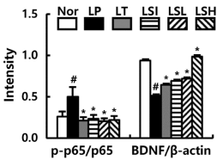
Ⅱ
DW2009
Development background
Soybean
- Senior friendly ingredient
- Soyasaponin I
(anti-inflammation,
cognition improving effect)
Microbiota-gut-brain axis
L. plantarum C29
Fermented soybean
powder
30 strains screened
for cognition improvement
Fermented soybean powder
improved cognition
The first functional ingredient for cognition
including probiotics In Korea

Slide 8
Ⅱ
DW2009
Publication
Published articles: 9 (SCI(E) journals)
*Journals submitted to KFDA: 3
1 | Molecular Nutrition Food Research, 2018, 62(20):e1800359 | *
2 | J Agricultural and Food Chemistry, 2017, 65:6877-85 (& 2021, 69:5573) | *
3 | Nutrients, 2021, 13(9):3273 | *
4 | Journal of Applied Microbiology, 2012, 113:1498-1506
5 | Anaerobe, 2014, 27:22-26
6 | Letters in Applied Microbiology, 2015, 60:307-314
7 | International Journal of Food Sciences and Nutrition, 2015, 66:912
8 | Journal of Microbiology and Biotechnology, 2018, 28:175-179
9 | Nutrients, 2019, 11(2):p305

Slide 9


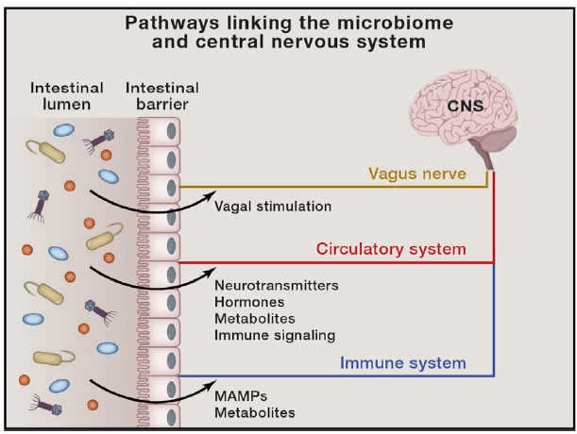
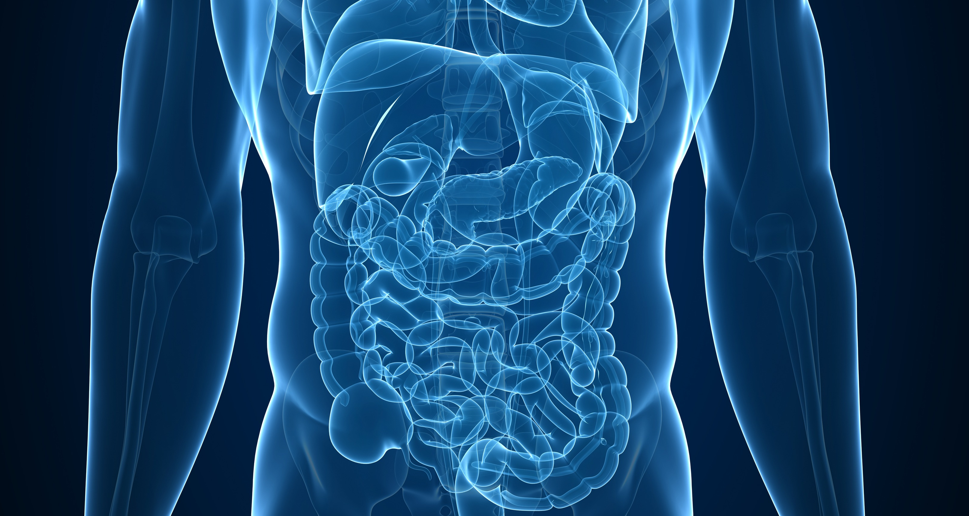
Ⅱ
DW2009
Mode of Action
Gut-brain axis (GBA)
Cognitive deficit
Cognitive improvement
bi-directional communication network that links the enteric and central nervous systems
BDNF ↓
BDNF ↑
Neuroinflammation ↑
Neuroinflammation ↓
Aging
Gut dysbiosis
Gut microbiota normalization
DW 2009
Cell Host Microbe, 2015, 17(5):565-76

Slide 10
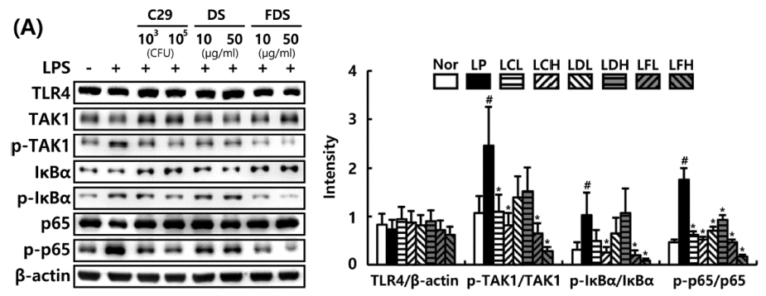
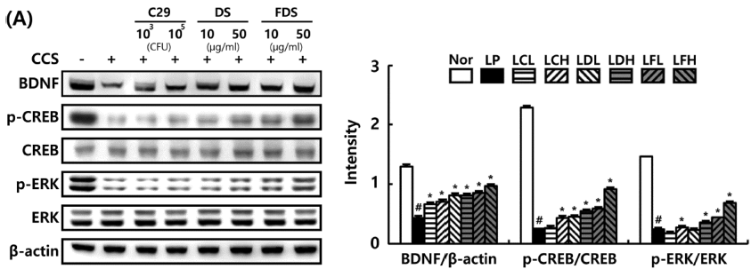
Ⅱ
DW2009
J. Agric. Food Chem. 2017, 65(32):6877–6885
In vitro
Anti-inflammation
10³
C29
10⁵
10
DS
50
10
FDS
50
4
DS: defatted soybean
FDS: DW2009
LP: LPS
LCL: LPS + C29 low (10³)cfu
LCH: LPS + C29 high (10⁵)cfu
LDL: LPS + Soybean low (10 μg/ml)
LDH: LPS + Soybean high (50 μg/ml)
LFL: LPS + DW2009 low (10 μg/ml)
LFH: LPS + DW2009 high (50 μg/ml)
(CFU)
(μg/ml)
(μg/ml)
3
#
LPS
TLR4
Intensity
#
TAK1
2
*
#
p-TAK1
1
*
*
*
IκBα
*
*
*
*
*
*
*
p-IκBα
0
*
*
p65
TLR4/β-actin
p-TAK1/TAK1
p-IκBα/IκBα
p-p65/p65
p-p65
β-actin
Nor
LP
LCL
LCH
LDL
LDH
LFL
LFH
Treatment of DW2009 significantly reduced expression level of inflammatory cytokines in BV-2 microglia cells.
Neurotrophic effects
10³
C29
10⁵
10
DS
50
10
FDS
50
3
DS: defatted soybean
FDS: DW2009
CCS: corticosterone (300 μM)
CCL: CCS+ C29 low (10³)
CCH: CCS + C29 high (10⁵)
CDL: CCS + Defatted Soybean low (10 μg/ml)
CDH: CCS + Defatted Soybean high (50 μg/ml)
CFL: CCS + DW2009 low (10 μg/ml)
CFH: CCS + DW2009 high (50 μg/ml)
CCS
(CFU)
(μg/ml)
(μg/ml)
BDNF
2
p-CREB
Intensity
*
CREB
1
*
*
*
*
*
*
*
*
*
p-ERK
#
#
*
*
#
*
*
*
ERK
0
BDNF/β-actin
p-CREB/CREB
p-ERK/ERK
β-actin
Nor
LP
LCL
LCH
LDL
LDH
LFL
LFH
Treatment of DW2009 increased the level of BDNF and p-CREB in SH-SY5Y neuroblastoma cells.

Slide 11
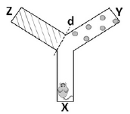
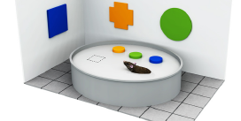
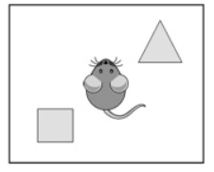
Ⅱ
DW2009
In vivo
Biomarker: BDNF, phospho-CREB
Behavior tests for cognition
Test | Morris water maze test | Novel object recognition test | Y-maze test
Objective | Spatial learning, memory | Memory | Spatial learning, short-term memory
L. plantarum C29
Fermented soybean powder
DW2009
Alzheimer’s disease mouse model(5xFAD)
LPS mouse model
Scopolamine mouse model
D-galactose mouse model
Aged rat model
IBO rat model
Biomarkers & Behavior
Significant changes confirmed
Test substance
6 different animal models

Slide 12
Ⅱ
DW2009
Nutrients, 2021, 13(9):3273
In vivo_LPS mouse
Improvement of cognition
Modulation of gut microbiota composition
Y-Maze
Novel object recognition
NC: Negative control
DP: LPS + Donepezil (1.5 mpk)
C29: LPS + L. plantarum C29
(1x10⁹ cfu)
DW: LPS + DW2009 (100 mpk)
DC: LPS + Donepezil (1.5 mpk)
+ L. plantarum C29
(1x10⁹ cfu)
DD: LPS + Donepezil (1.5 mpk)
+ DW2009 (100 mpk)
0
y
0.2
2.0
0.06
R²=0.0605
p=0.089
0.2
LPS
1.5
100
a
a
a
a
a
a
100
a
C29
Bacteroidales_uc/
bacteroifaceae (ratio x 100)
80
80
1.0
Bacteroidales_uc (%)
60
b
60
c
ab
ab
ab
b
b
z
DC
0.03
40
Exploration(%)
NC
Spon. alternation (%)
40
0
DP
0.5
20
20
DW
0
NC
LPS
DP
C29
DW
DC
DD
0
NC
LPS
DP
C29
DW
DC
DD
DD
0
LPS
DP
C29
DW
DC
DD
0
x
0
-0.2
NC
45.00
70.00
90.00
Spon. alternation (%)
Improvement of cognitive function
Effects on β-diversity and modulation of gut microbiota
Anti-inflammation
Gut
Hippocampus (brain)
200
c
b
ab
ab
50
d
bc
c
bc
200
a
ab
bc
abc
40
60
c
ab
100
a
a
a
a
a
150
a
ab
ab
40
b
b
150
bc
c
30
b
a
a
a
a
40
bc
ab
ab
80
a
IL-1β (pg/mg)
30
a
d
IL-1β (pg/mg)
a
a
ab
a
60
b
100
TNF-α (pg/mg)
IL-10 (pg/mg)
TNF-α (pg/mg)
IL-10 (pg/mg)
20
100
20
20
40
50
10
50
10
20
0
NC
LPS
DP
C29
DW
DC
DD
0
NC
LPS
DP
C29
DW
DC
DD
0
NC
LPS
DP
C29
DW
DC
DD
0
NC
LPS
DP
C29
DW
DC
DD
0
NC
LPS
DP
C29
DW
DC
DD
0
NC
LPS
DP
C29
DW
DC
DD
Decrease of inflammatory cytokines and increase of anti-inflammatory cytokines in gut / hippocampus

Slide 13
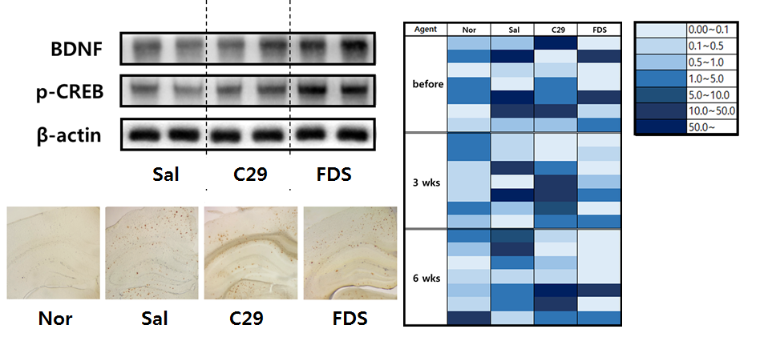
Ⅱ
DW2009
Mol Nutr Food Res, 2018, 62(20):e1800359
In vivo_5xFAD mice
Improvement of cognition
Gut microbiota normalization
Morris Water Maze
Y-Maze
Time (week) | Nor | Tg | C29 | DW2009
0
3
6
8
45
*
90
*
*
*
30
60
#
Time spent
in target qudrant (s)
#
Spon.alternation
15
30
Enterobacteriaceae /
Bifidobacteria + Lactobacili
0
Nor
Tg
C29
DW2009
0
Nor
Tg
C29
DW2009
Nor: normal, Tg: 5xFAD, C29; L. plantarum C29 in 5xFAD (1x10⁹ cfu), DW2009; DW2009 in 5xFAD (100 mpk)
Improvement of cognitive function
Neurotrophic effects
0
Nor
C29
DW2009
1~5
6~10
BDNF
11~50
51~100
p-CREB
101~500
500~
β-actin
Increase of neurotrophic factors and normalization of gut microbiota

Slide 14
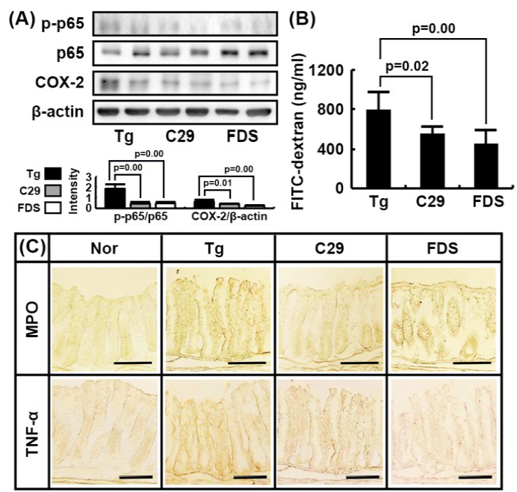
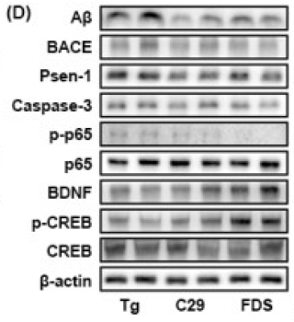
Ⅱ
DW2009
Mol Nutr Food Res, 2018, 62(20):e1800359
In vivo_5xFAD mice
Anti-inflammation
Gut
Hippocampus (brain)
Tg
C29
DW2009
(DW2009)
Decrease of inflammation makers in gut / hippocampus
Decrease of gut permeability
Decrease of apoptosis marker in hippocampus

Slide 15
Ⅱ
DW2009
Safety
GLP toxicity study (DW2009)
Category
Test
Result
Single dose toxicity study (Rat, Dog)
MTD > 5,000mg/kg
General
toxicology
4 weeks repeated dose range finding study (Dog)
MTD > 5,000mg/kg
13 weeks repeated dose toxicity study (Rat)
NOAEL ≥ 3,000mg/kg
Bacterial reverse mutation test
Negative
Genetic
toxicology
Chromosomal aberration test
Negative
Micronucleus test
Negative
Probiotics safety (L. plantarum C29)
Probiotics
Test
Result
① Antibiotic resistance test
② Activity of metabolism (D-lactate/Bile salt hydroxylase)
③ Production of toxins (LDH assay)
④ Hemolysis
⑤ The presence of biogenic amines
⑥ Mucin degradation
L. plantarum C29
No issues

Slide 16
Ⅱ
DW2009
Nutrients 2019, 11(2),305
Clinical trial
Item | Experimental design
Title | A 12 Week treatment, multi-center, randomized, double-blind, placebo-controlled study to assess the efficacy and safety of DW2009 in cognition in people with mild cognitive impairment
Collaborators | Jeonbuk National University Hospital (Psychiatry department, Young Chul Chung) Kyung Hee University Medical Center (Psychiatry department, Jong-Woo Paik)
Interventions | 800 mg once daily via 2 capsules (complex of Lactobacillus plantarum C29 Probiotics and fermented soybean) vs. placebo (cellulose 800 mg once daily)
DW2009, n = 50
Placebo , n = 50
Visit 1
(Screening)
Visit 2
(D-0)
Visit 3
(D+42(±7))
Visit 4
(D+84(±5))
Randomization
End

Slide 17
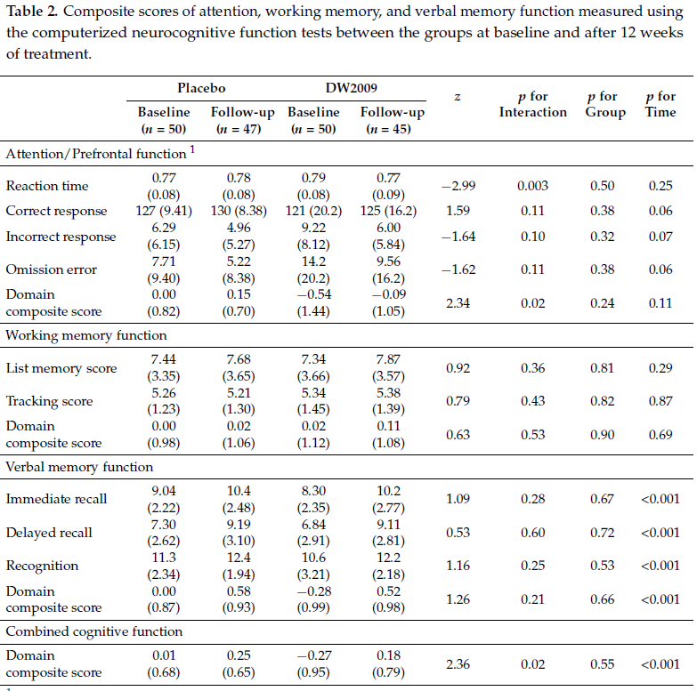
Ⅱ
DW2009
Clinical trial
Primary endpoint: Improvement of cognition
1.0
Placebo
DW2009
0.8
p for interaction
= 0.02
p for interaction
= 0.02
0.6
Change in cognitive functions
0.4
Improved cognitive performance
0.2
0.0
Attention /
Prefrontal
function
Working
memory
Verbal
memoty
Combined
cognitive
function
Cognitive function, especially Attention/Prefrontal function, was improved in DW2009 group
Nutrients 2019, 11(2),305

Slide 18
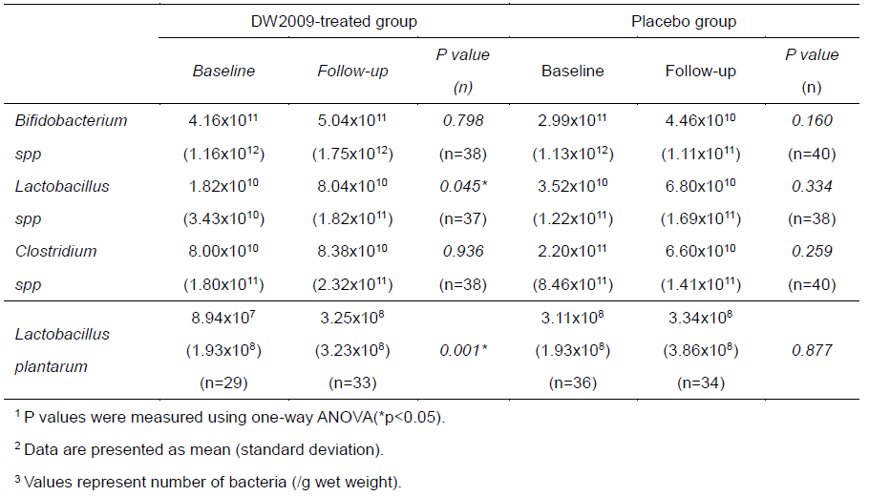
Ⅱ
DW2009
Clinical trial
Clinical trial
Secondary endpoint:
Correlation of cognition and BDNF levels
Secondary endpoint:
Gut microbiota composition
DW2009 group
Placebo group
3
3
2
2
p = 0.007
p = 0.147
Change in Cognitive Function
Change in Cognitive Function
1
1
0
0
-1
-1
0
0
10,000
20,000
30,000
10,000
20,000
-30,000
30,000
-20,000
-10,000
-30,000
-20,000
-10,000
Change in BDNF levels
Change in BDNF levels
Positive correlation was shown in change of cognitive function and
BDNF levels in DW2009 group
Lactobacillus was significantly increased in DW2009 group
Nutrients 2019, 11(2),305

Slide 19
Ⅱ
DW2009
Clinical trial
Clinical trial
Safety: Summary of adverse events
 | DW2009 |  |  | Placebo |  |  | p-value*
 | patients | rate (%) | events | patients | rate (%) | events
Adverse events (AE) | 6 | 12.00 | 7 | 3 | 6.00 | 5 | 0.4870
Severe adverse events (SAE) | 1 | 2.00 | 1 | 0 | 0.00 | 0 | 1.0000
Termination related to AE | 0 | 0.00 | 0 | 0 | 0.00 | 0
7 cases in DW2009 group, 5 cases in placebo group
Main adverse events
- DW2009: dyspepsia, vertigo, headache
- Placebo: constipation, headache, nausea, rash
Severe adverse events
- DW2009: 1 case (pulmonary tumor), unrelated to DW2009
Nutrients 2019, 11(2),305

Slide 20
Ⅲ
Summary
Summary
MoA
Increase of BDNF and decrease of neuroinflammation through gut microbiota normalization
Efficacy
Improvement of cognitive function in clinical study
Toxicology
Favorable safety profile with no adverse events (ADI > 1,800 mg/day)
CMC
Manufactured under cGMP facility
Stability test completed (Expiration date of 2 years)
Advantage
The first functional probiotics ingredient for cognition improvement in Korea
Correlation of BDNF and cognitive function confirmed
Development
stage
Product was released on July 29, 2024
Preparing for GRAS registration

Slide 21
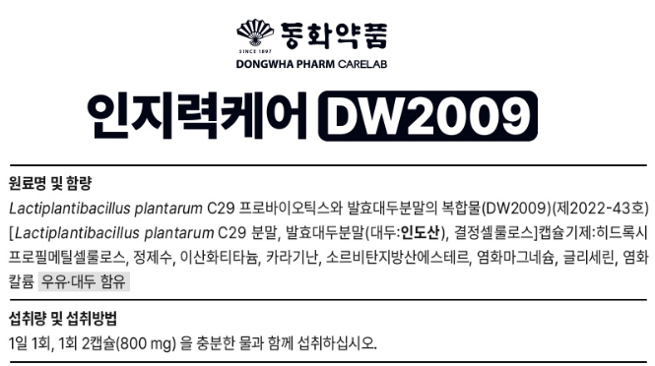
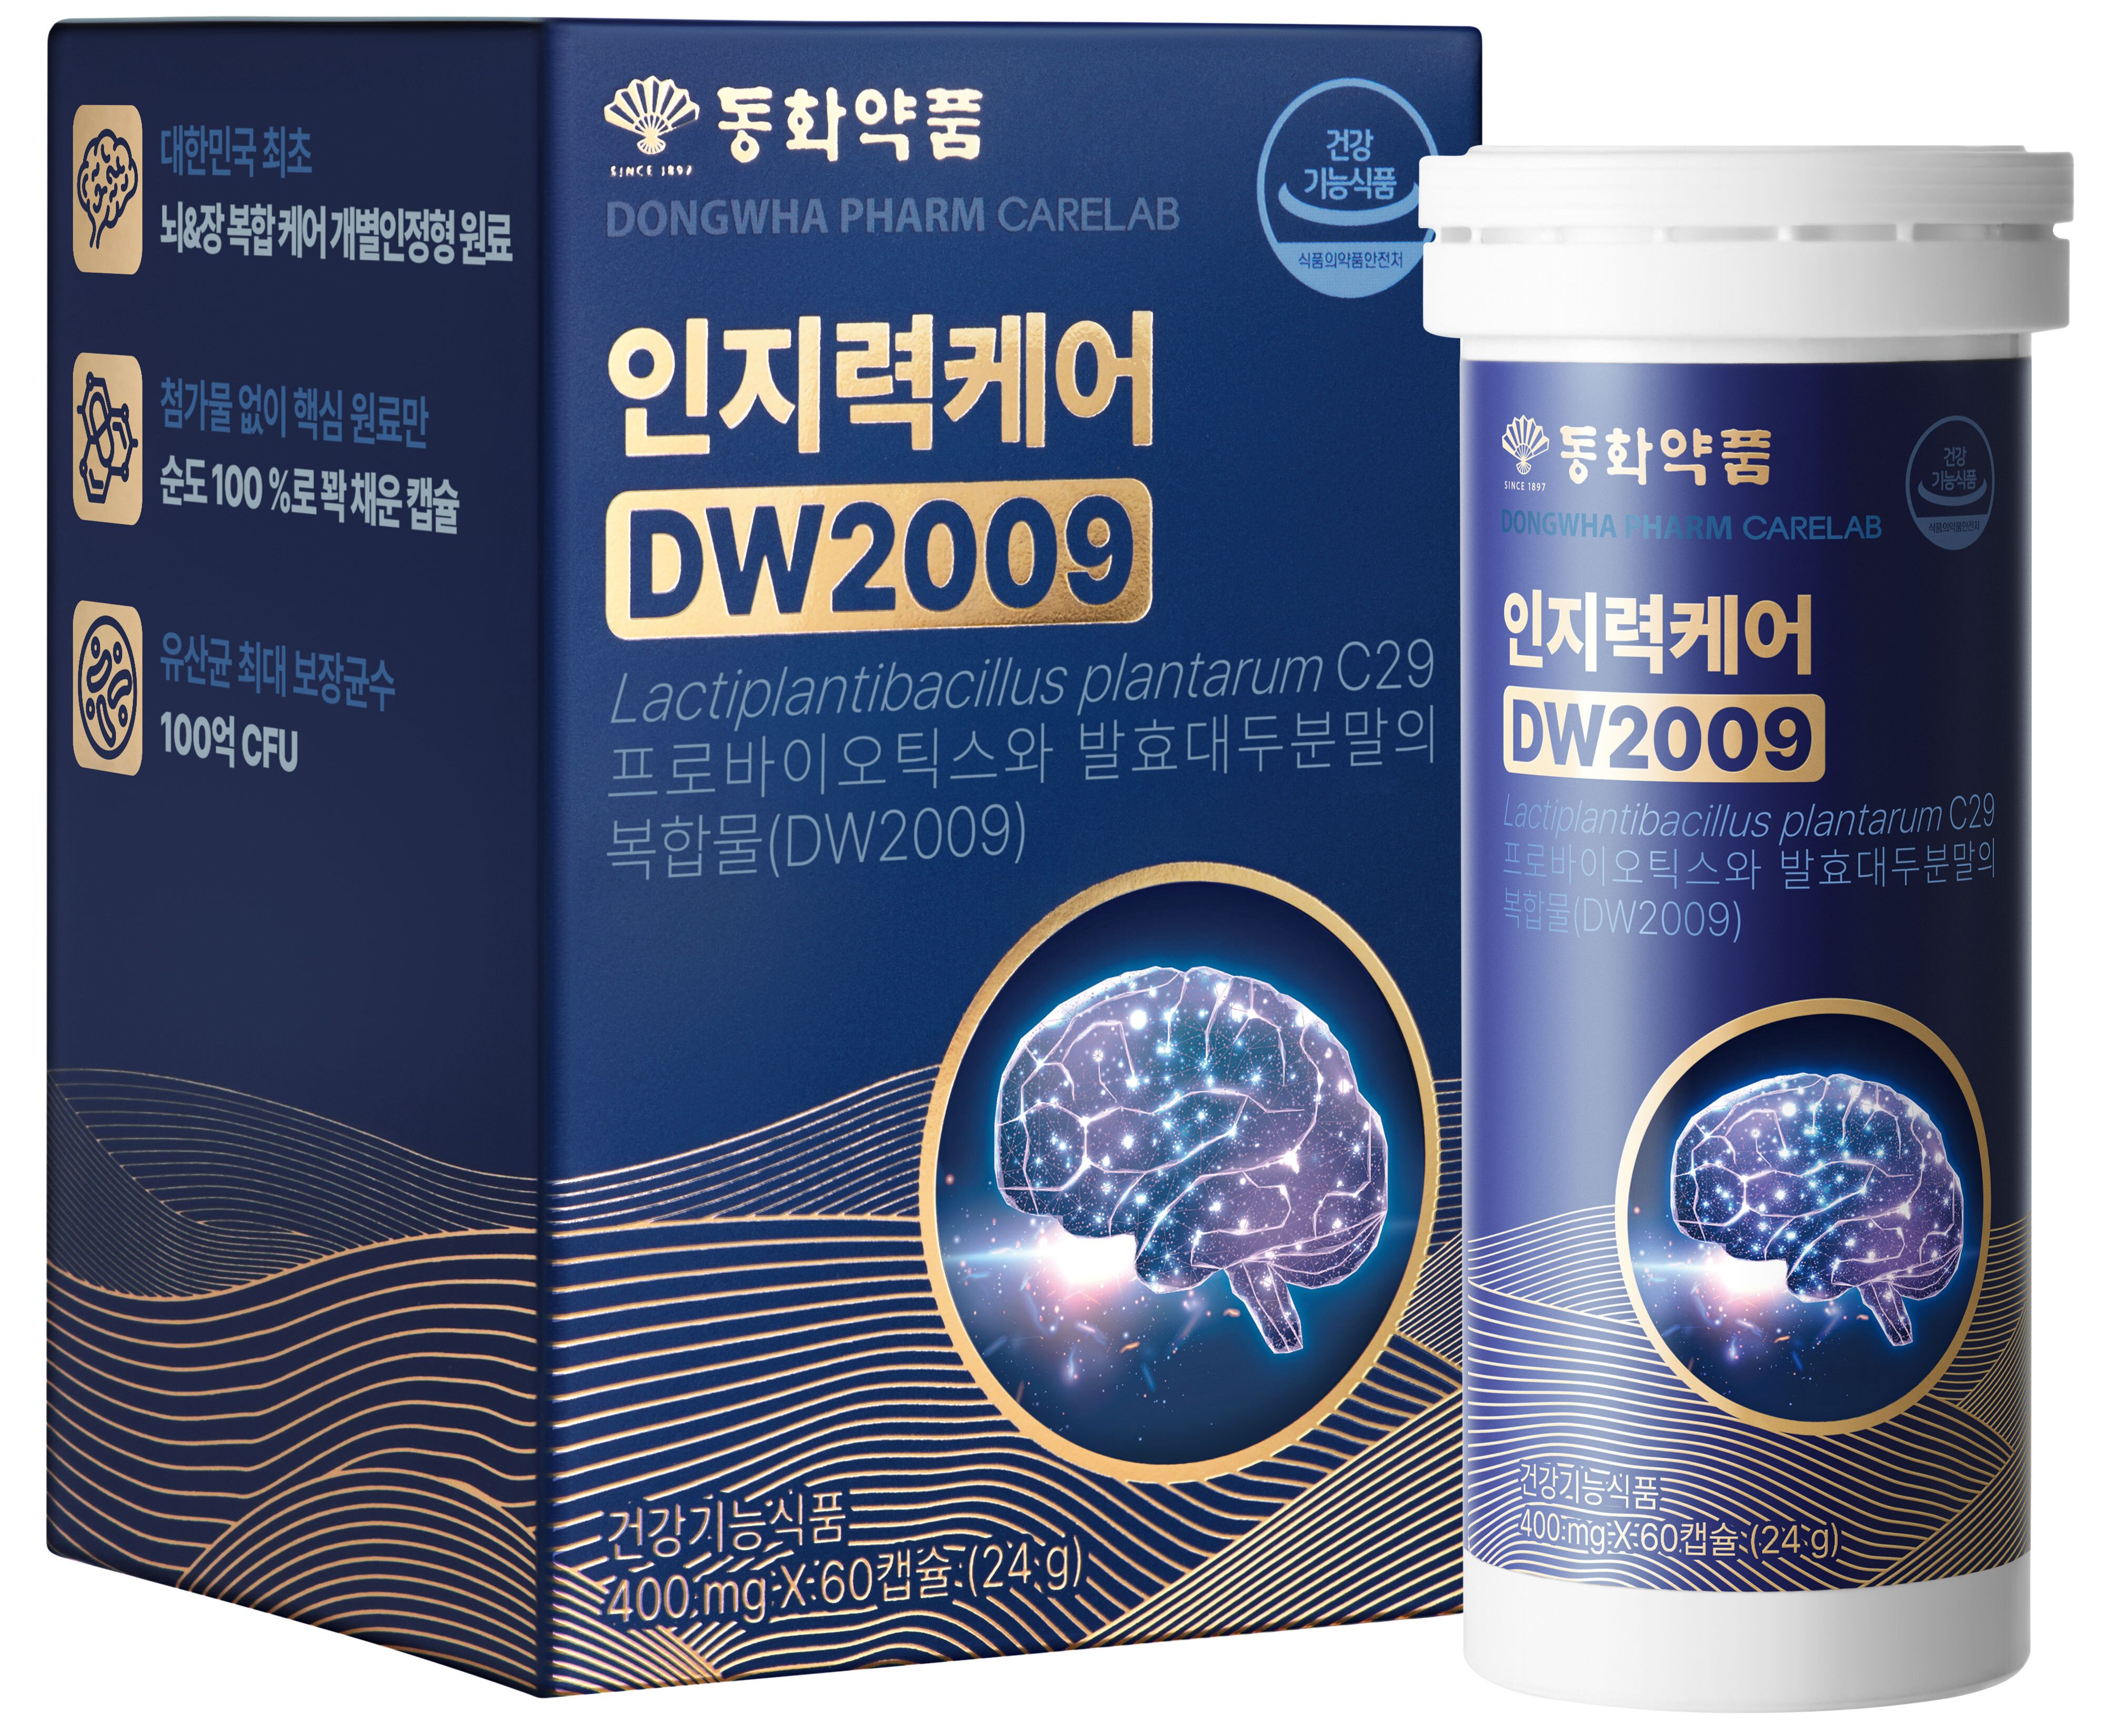
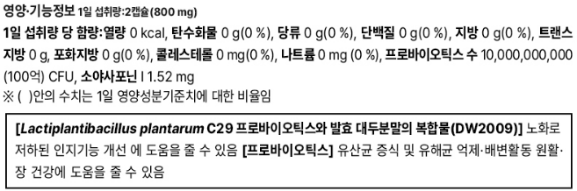
Ⅲ
Summary
Product – Cognition care DW2009
Helps Improvement of cognitive function decreased by aging

Slide 22
Oldest to best Dong wha Pharm
THANK YOU

